Slide 1
Humanitarian Funding in Bangladesh Over Five Years (2018-2022) by Muammer Galib Mahdi

Slide 2
Humanitarian Situation in Bangladesh
By 2022 Bangladesh hosts 9,29,606 Rohingya refugees in Cox’s Bazar and 26,908 in Bhasan Char.
Flash flood in North-East in 2022 after the seasonal flood, affected 7.2 million people including 3.5 million children.
Covid-19 situation from 2020-2022, made humanitarian crisis only worse.
Till 2022 UNICEF reached 5.9 million people with 40% of them being children.

Slide 3
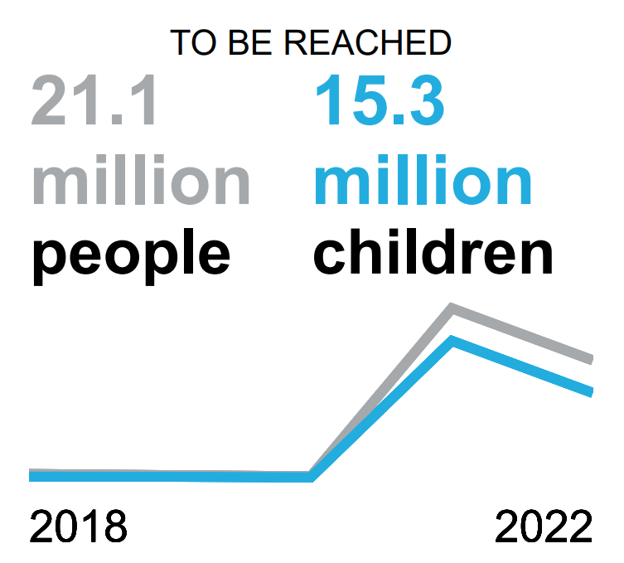
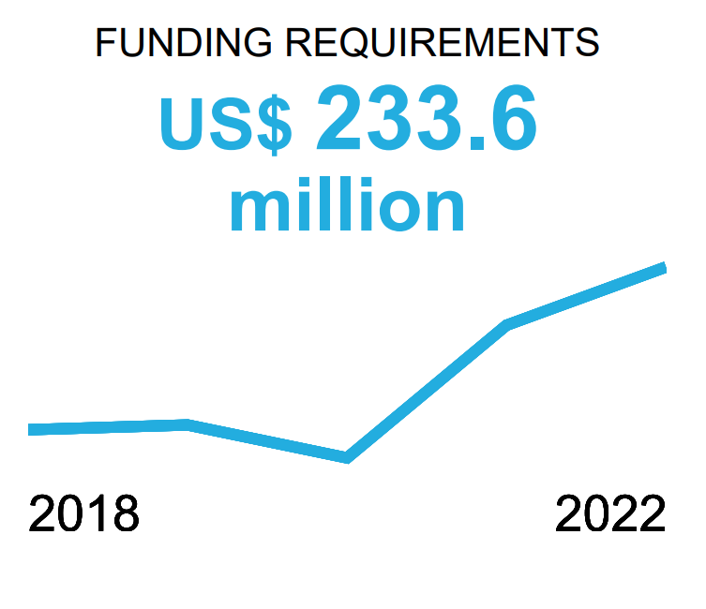
Funding requirements
Slight decrease in “people to be reached” in 2022 from 2021 due to covid lockdown being lifted, overall rise from 2018.
Rise in funding requirements in 5 years. UNICEF appeals $233.6 million for life saving services for aid in 2022.
Source: UNICEF

Slide 4
Reported funding over 5 years
Response plan/appeal from inside the country and outside, 2018-2022.
Decline in both over 5 years.
Data Source: UNOCHA, Financial Tracking Service, Country data: Bangladesh

Slide 5
Regular source of funds 2018-2022
The graph illustrates largest source of fund for 5 years.
USA being the biggest donor every year.
Data Source: UNOCHA, Financial Tracking Service, Country data: Bangladesh

Slide 6
Funding by Sector 2018-2022
This graph depicts reported humanitarian funding for the humanitarian causes by technical area/sector for 5 years
The single sector to receive largest funding every year in Food Security.
Data Source: UNOCHA, Financial Tracking Service, Country data: Bangladesh

